Slide 1
CS 347 Final Project Review
Ender Ceylan
Addison Juarez
Jamsheed Yazdani

Slide 2
Part 1

Slide 3
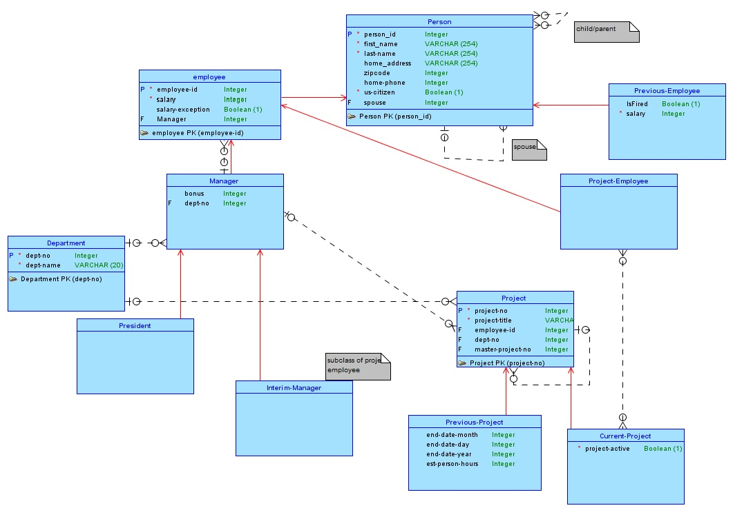

Slide 4
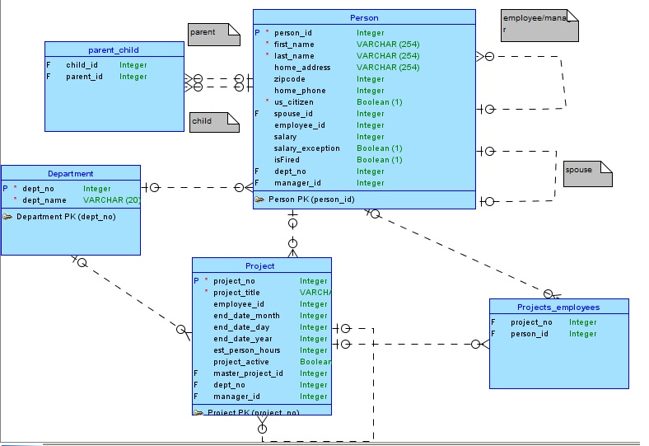

Slide 5
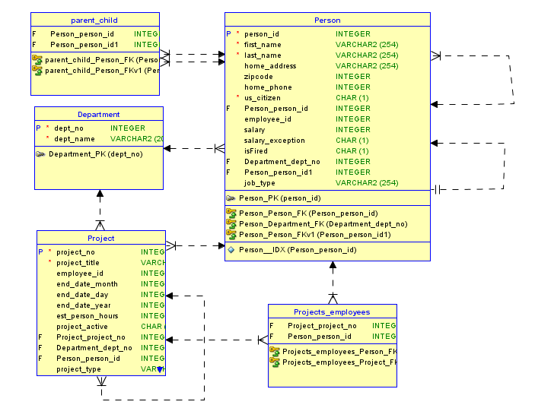

Slide 6
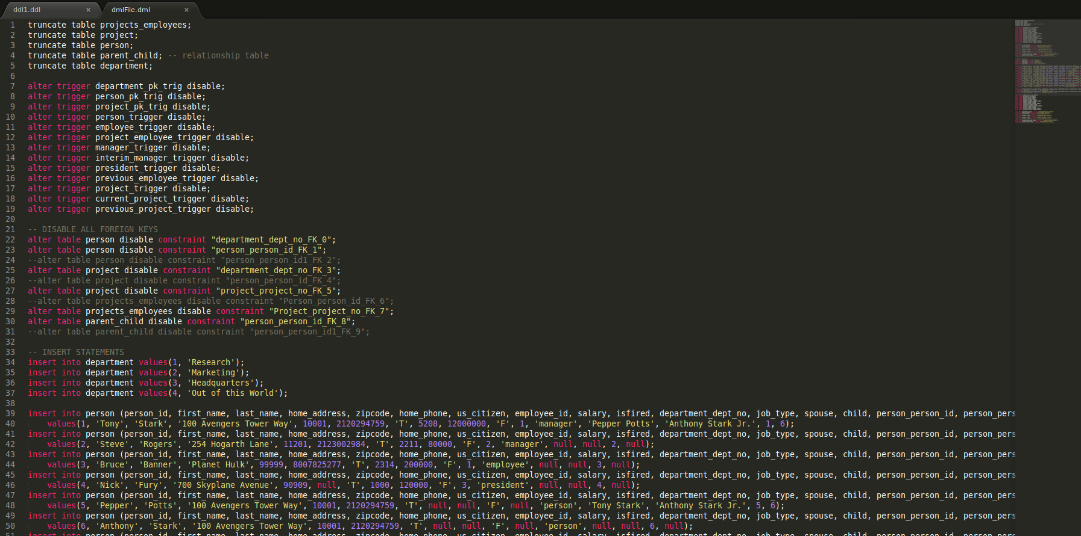

Slide 7
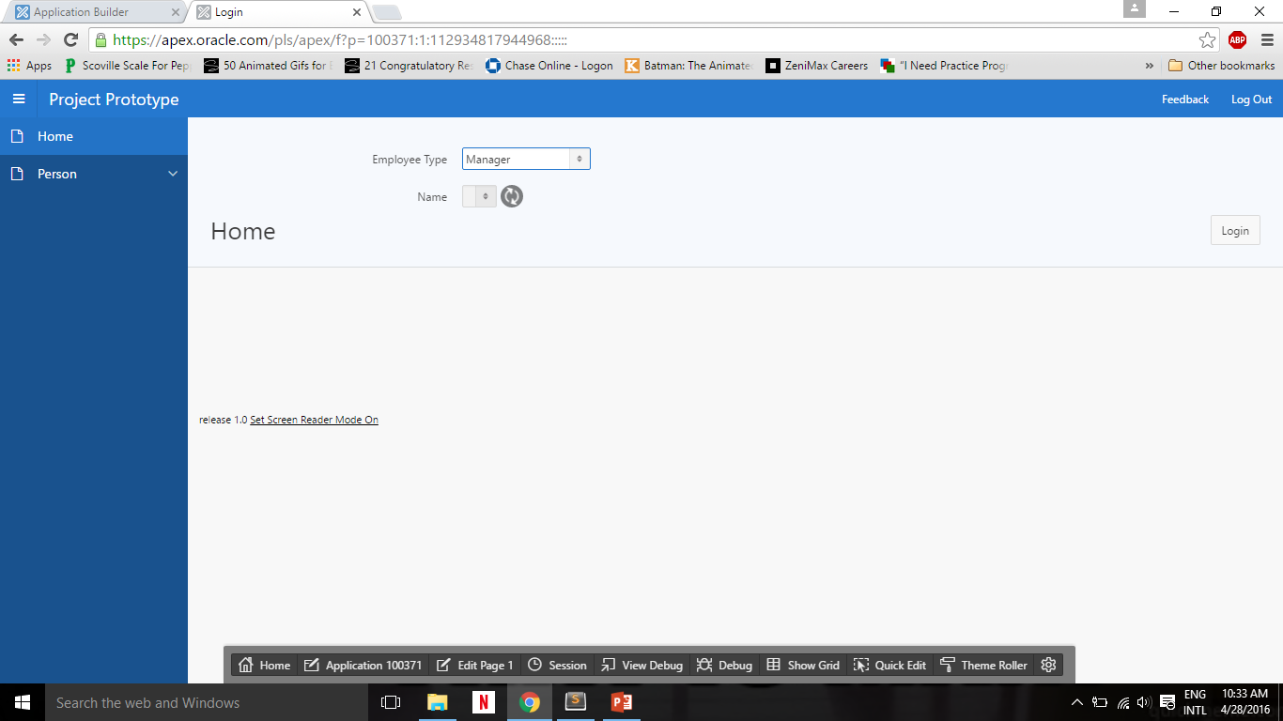

Slide 8
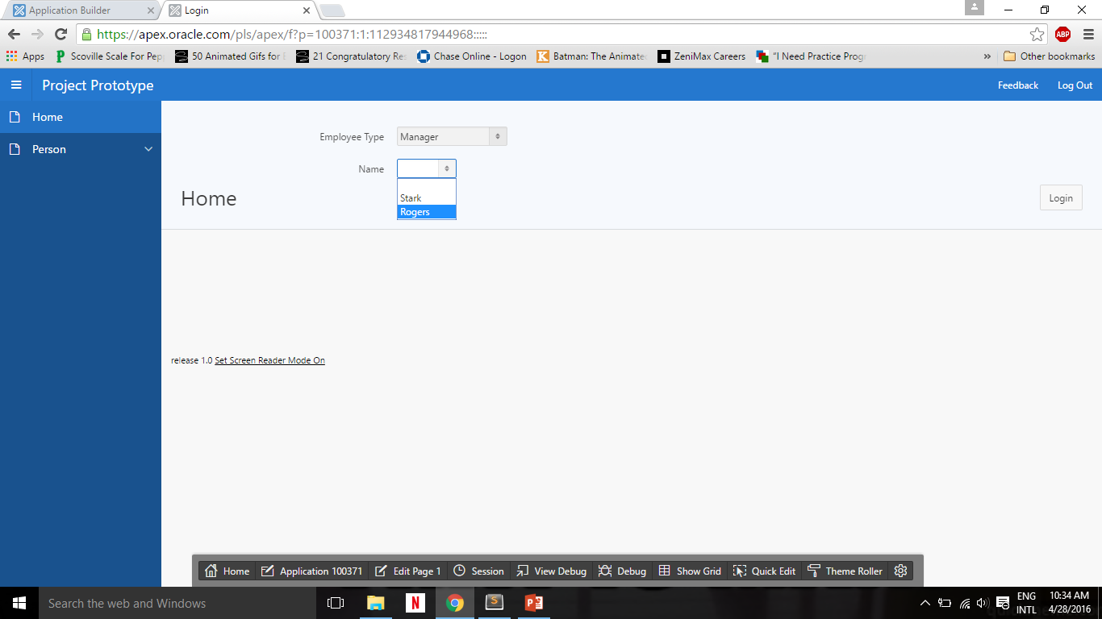

Slide 9
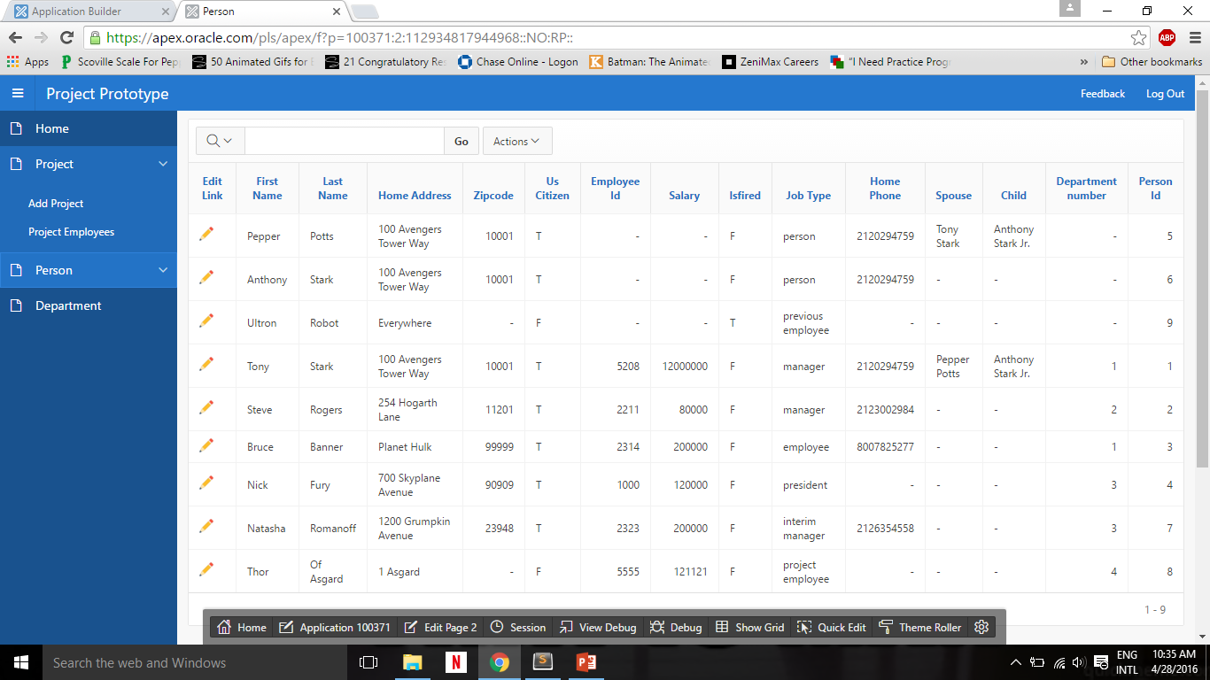

Slide 10
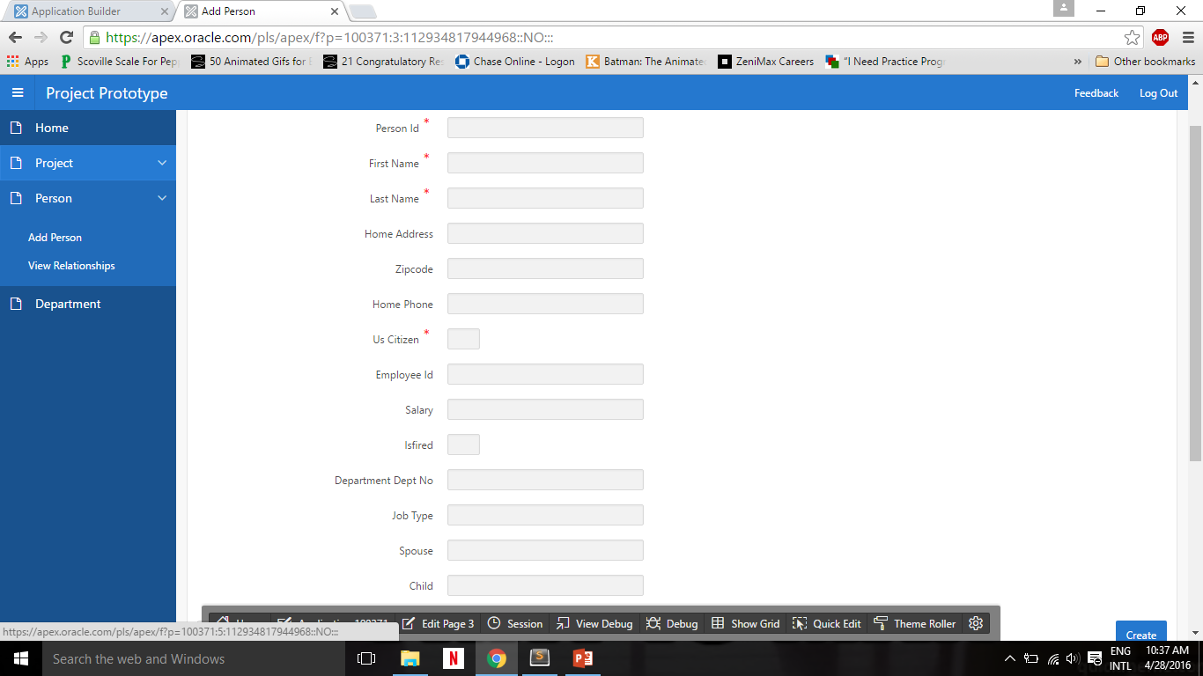

Slide 11


Slide 12
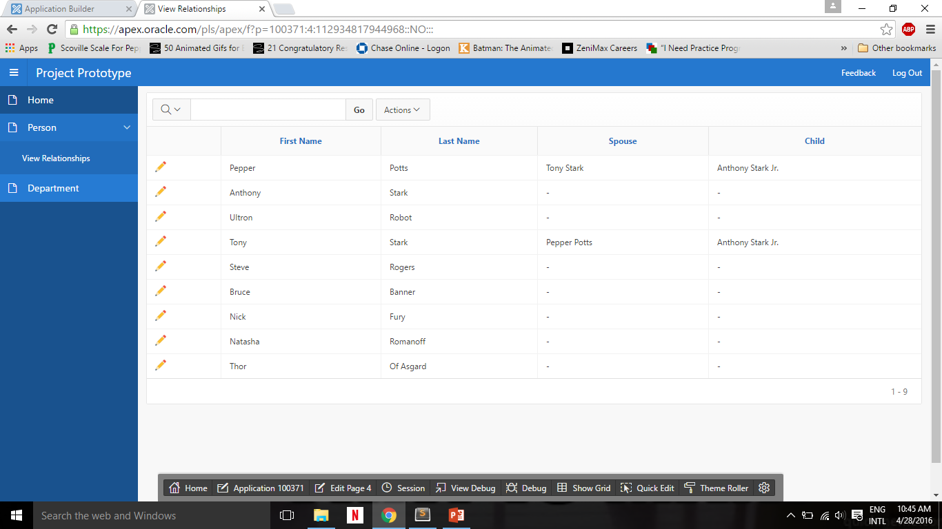

Slide 13


Slide 14
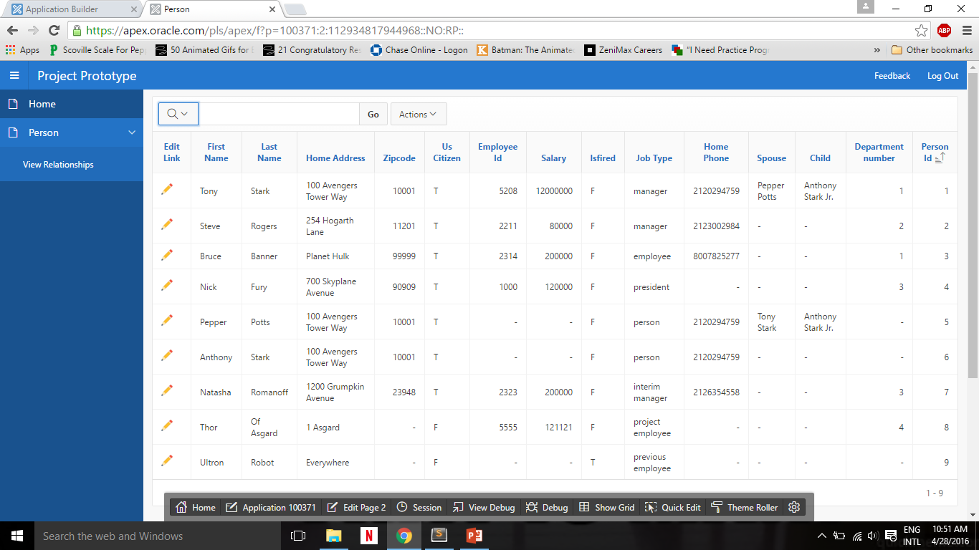

Slide 15


Slide 16
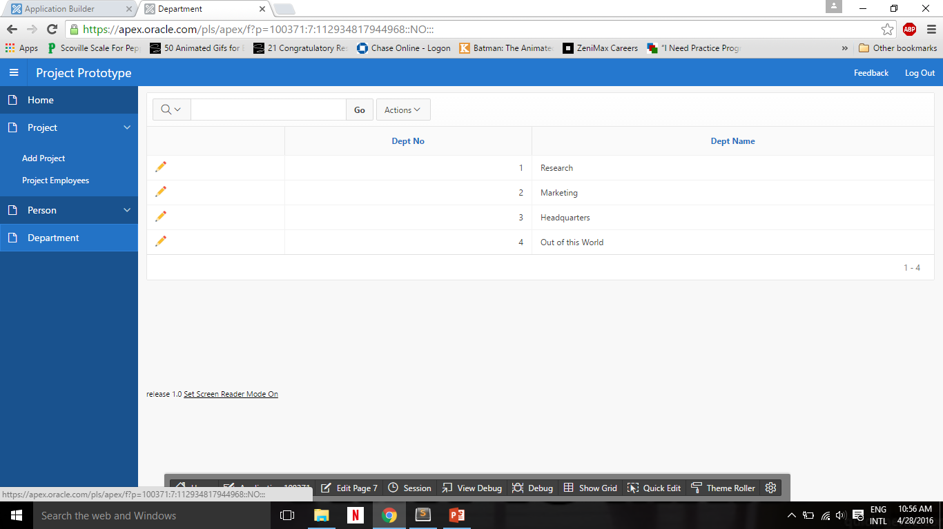

Slide 17


Slide 18
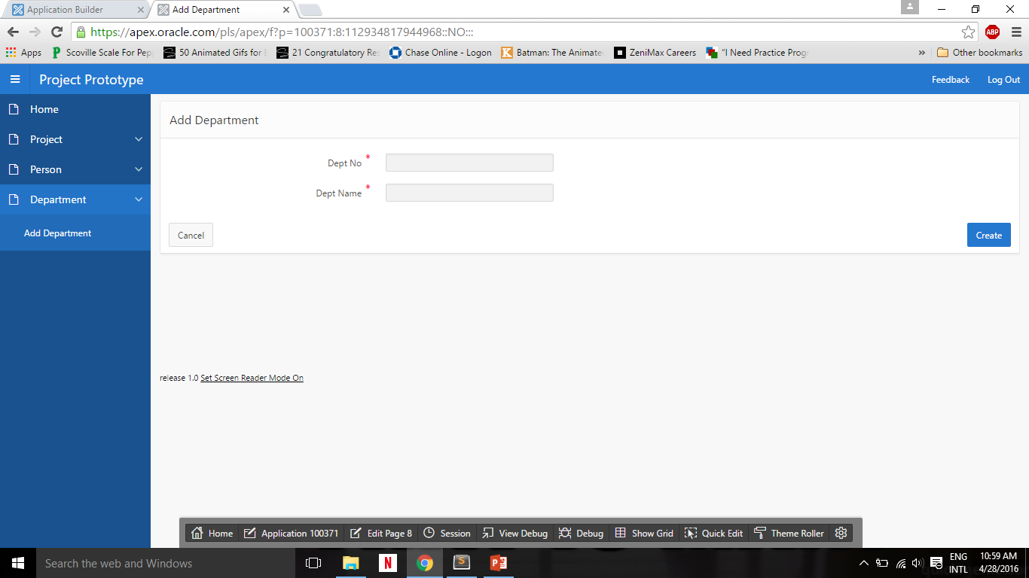

Slide 19
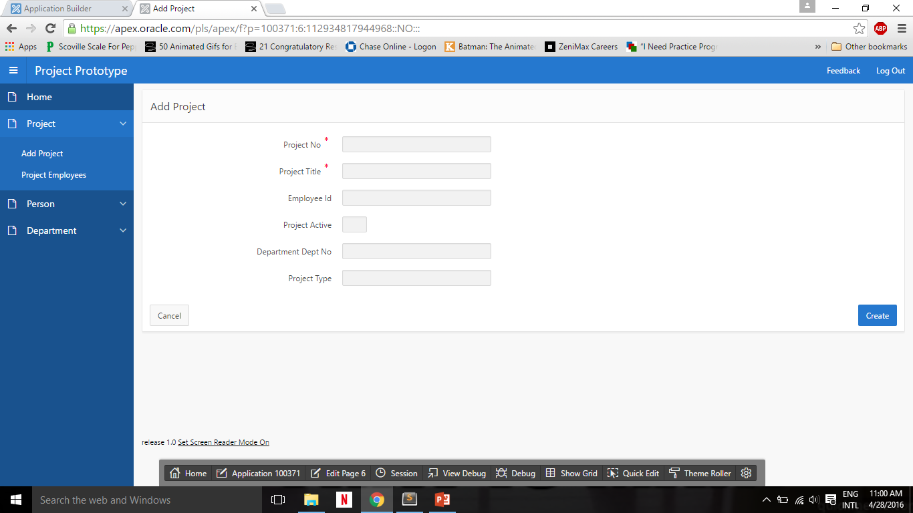

Slide 20
Part 2

Slide 21
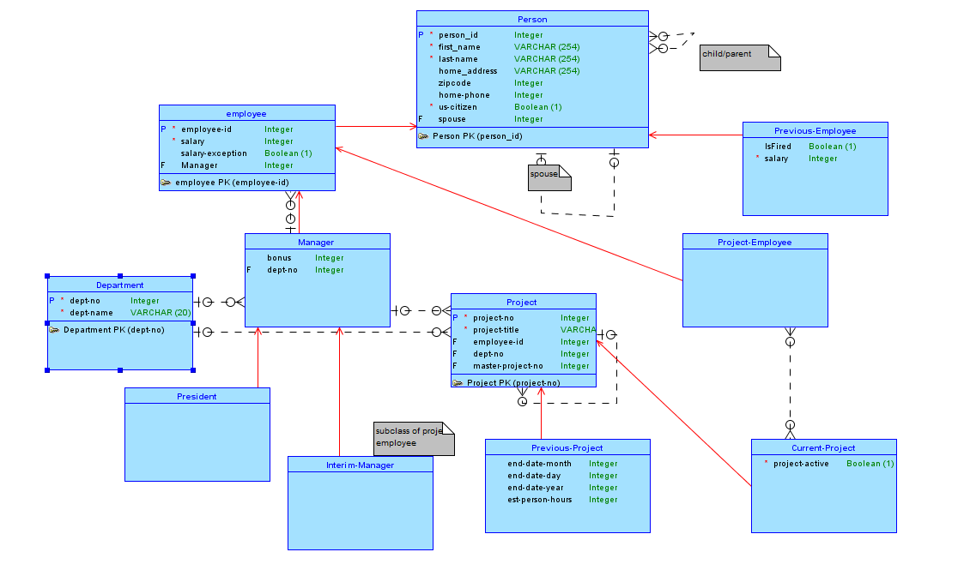
Conceptual Model
Notes:
<number>

Slide 22
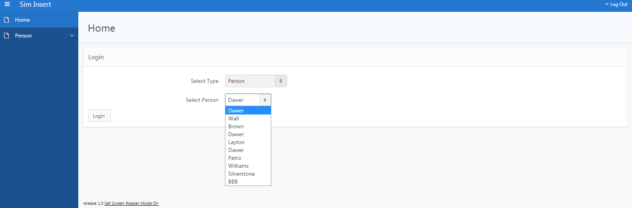
Login Page
Notes:
<number>

Slide 23
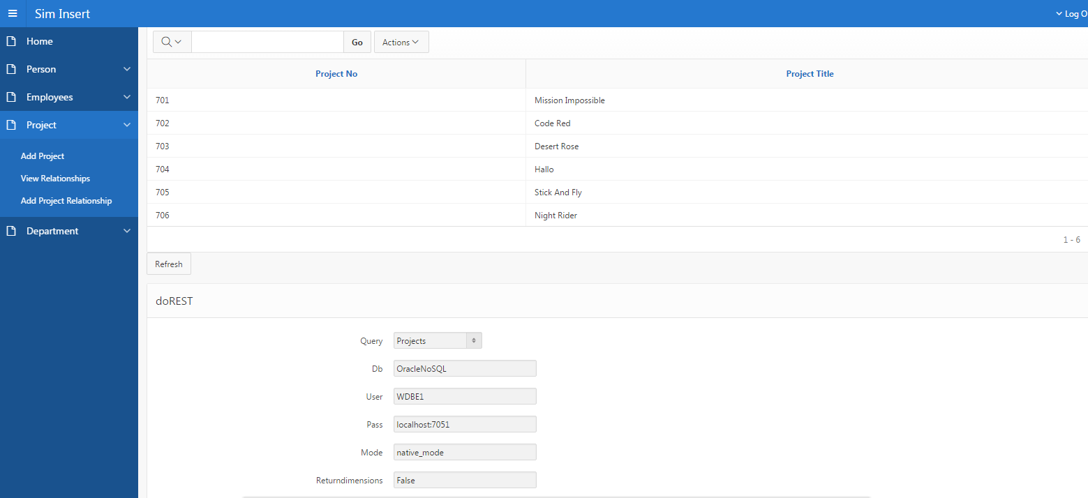
Form and Report
Notes:
<number>

Slide 24
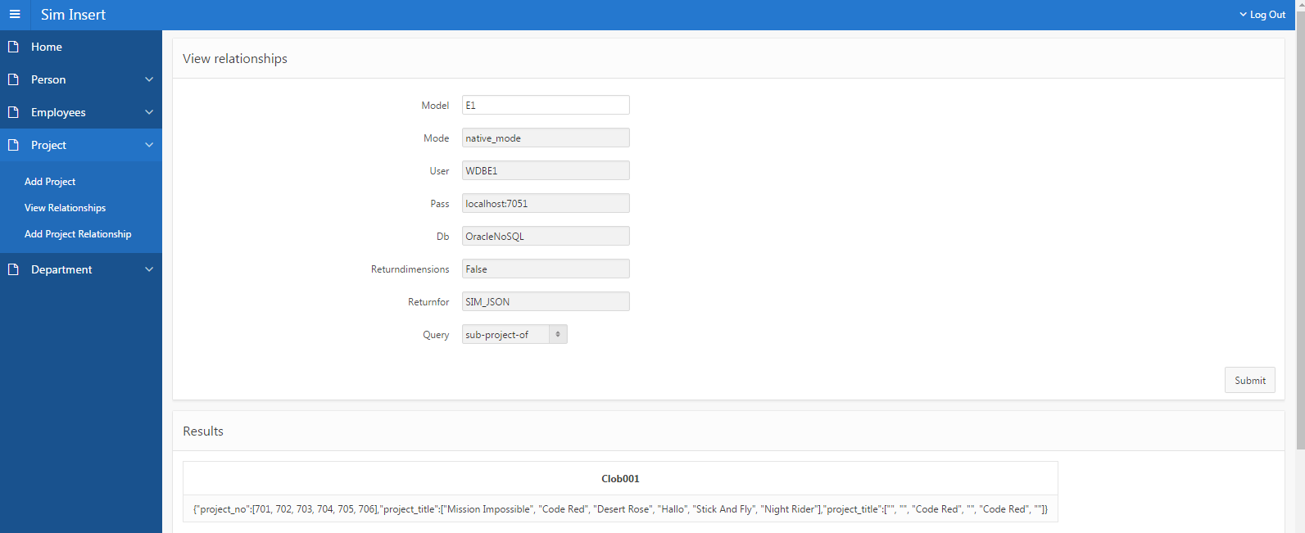
Relationships
Notes:
<number>

Slide 25
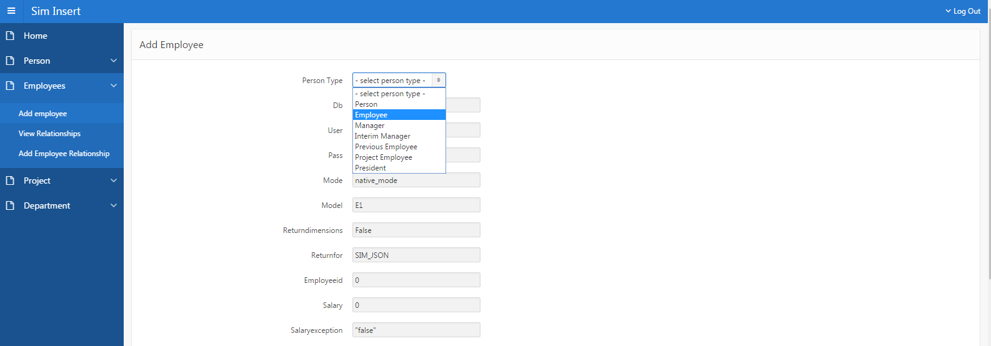
Add Class Form
Notes:
<number>

Slide 26
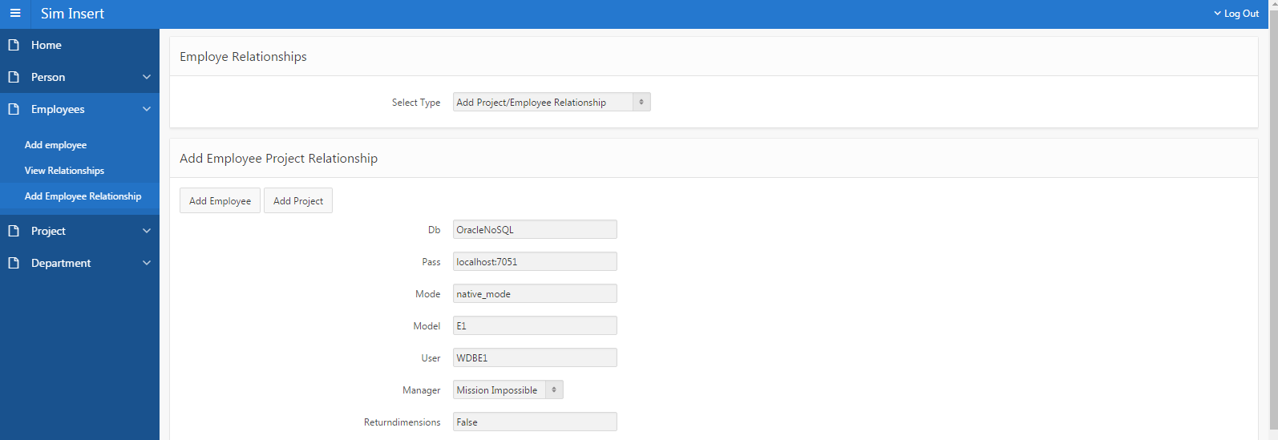
Add Relationships
Notes:
<number>

Slide 27
SIM DDL
Cleaned up Bo Li Thesis Example.carnot.sim
Notes:
<number>

Slide 28
APEX URL
https://apex.oracle.com/pls/apex/f?p=1051:1:111135899442851:::::
Notes:
<number>

